Slide 1
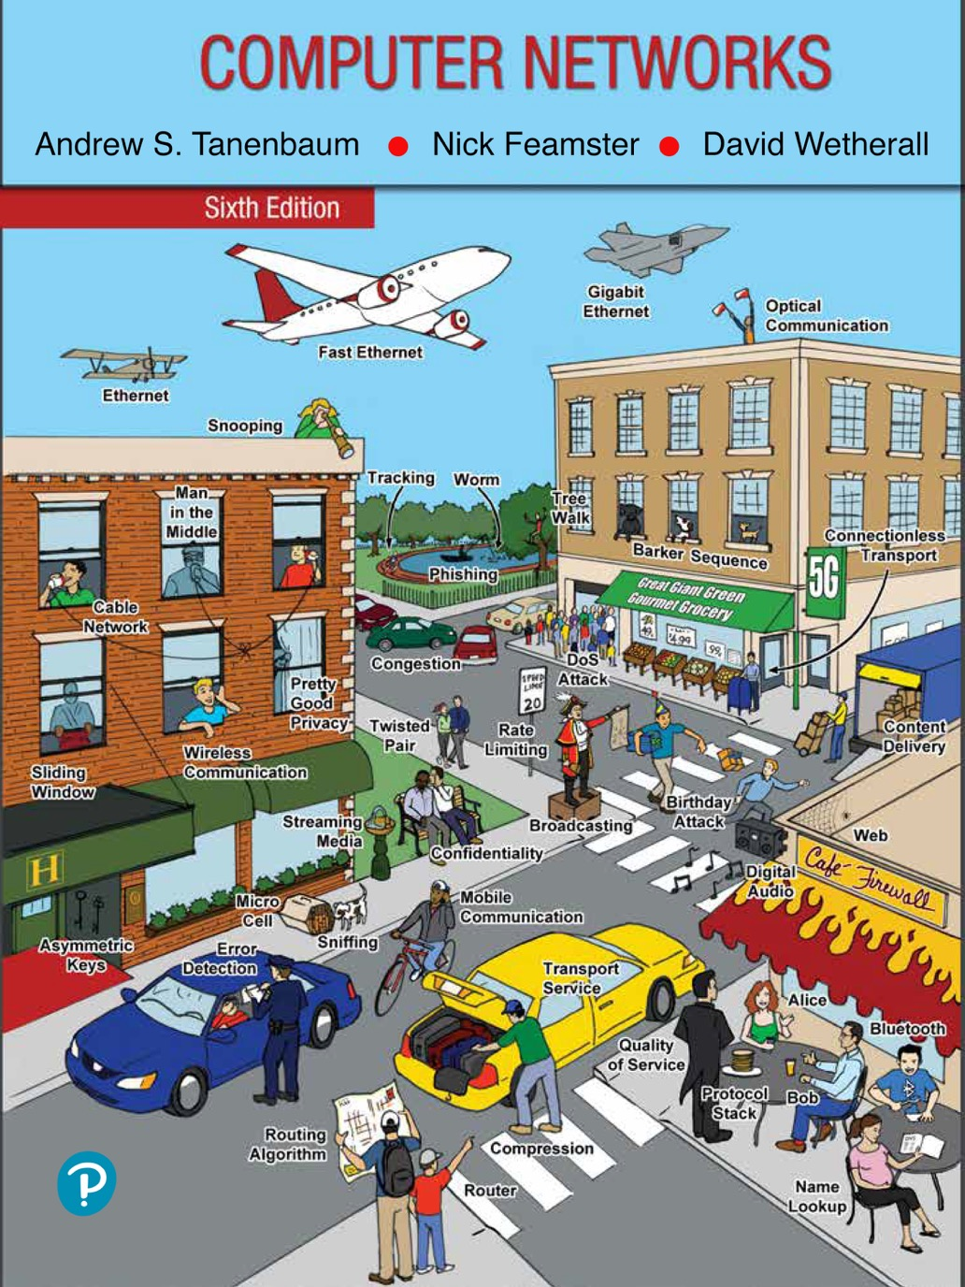
Chapter 5
The Network Layer

Slide 2
Network Layer Design Issues
Store-and-forward packet switching
Services provided to the transport layer
Implementation of connectionless service
Implementation of connection-oriented service
Comparison of virtual-circuit and datagram networks

Slide 3
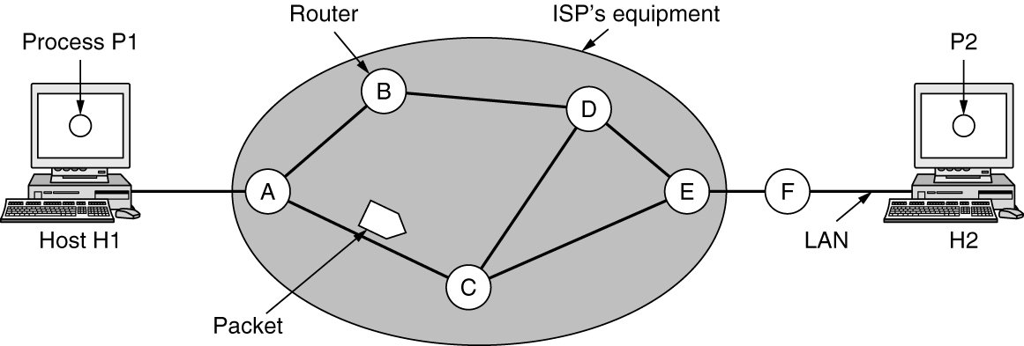
Store-and-Forward Packet Switching
A host with a packet to send transmits it to the nearest router.
The packet is stored there until it has fully arrived, and the link has finished its processing by verifying the checksum.
Then it is forwarded to the next router along the path until it reaches the destination host, where it is delivered.
This mechanism is store-and-forward packet switching
The environment of the network layer protocols

Slide 4
Services Provided to the Transport Layer
Services independent of router technology
Transport layer shielded from number, type, topology of routers
Network addresses available to transport layer use uniform numbering plan
Even across LANs and WANs

Slide 5
Battle between two warring factions
One camp (represented by the Internet community) argues that the routers’ job is moving packets around and nothing else. This viewpoint leads to the conclusion that the network service should be connectionless.
The other camp (represented by the telephone companies) argues that the network should provide a reliable, connection-oriented service.

Slide 6
Connectionless VS Connection Oriented
Connectionless service:
packets are injected into the network individually
Routed independently of each other
No advance setup is needed
The packets are frequently called datagrams
The network is called a datagram network
Connection-oriented service:
A path is established from the source router to destination router. This connection is called a VC (Virtual Circuit)
The network is called a virtual-circuit network

Slide 7
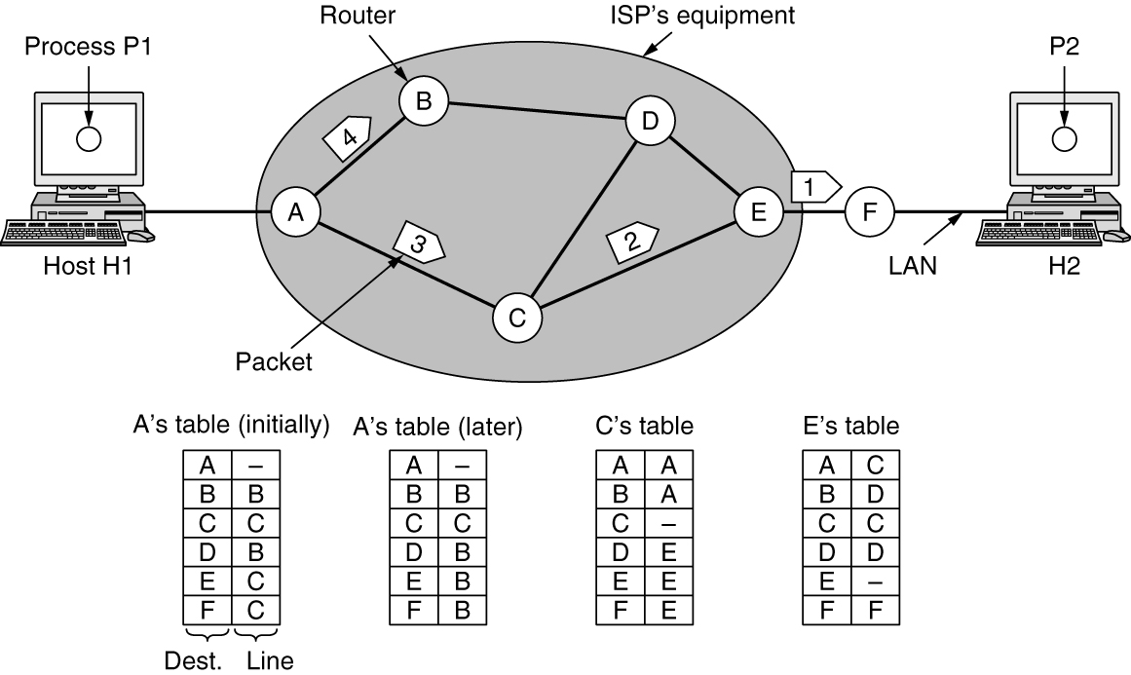
Implementation of Connectionless Service
Datagram Network
Suppose that the process P1 has a long message for P2.
It hands the message to the transport layer, with instructions to deliver it to process P2 on host H2. The transport layer code runs on H1, typically within the operating system.
Let us assume for this example that the message is four times longer than the maximum packet size, so the network layer has to break it into four packets, 1, 2, 3, and 4

Slide 8
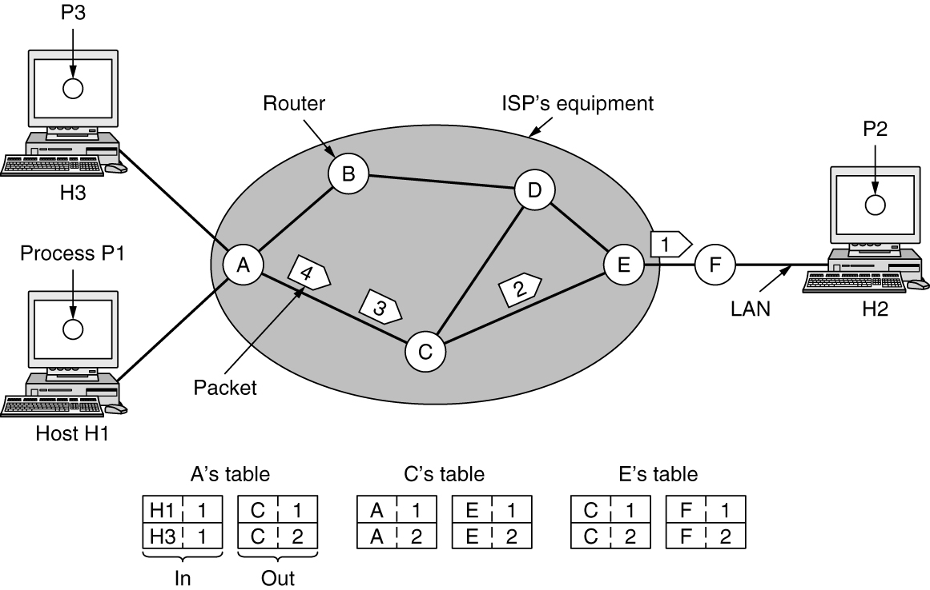
Implementation of Connection-Oriented Service
Virtual-Circuit Network
Here, host H1 has established connection 1 with host H2.
This connection is remembered as the first entry in each of the routing tables.
The first line of A’s table says that if a packet bearing connection identifier 1 comes in from H1, it is to be sent to router C and given connection identifier 1.
Similarly, the first entry at C routes the packet to E, also with connection identifier 1.

Slide 9
Question for you
What are the differences between datagram network and virtual-circuit network?

Slide 10
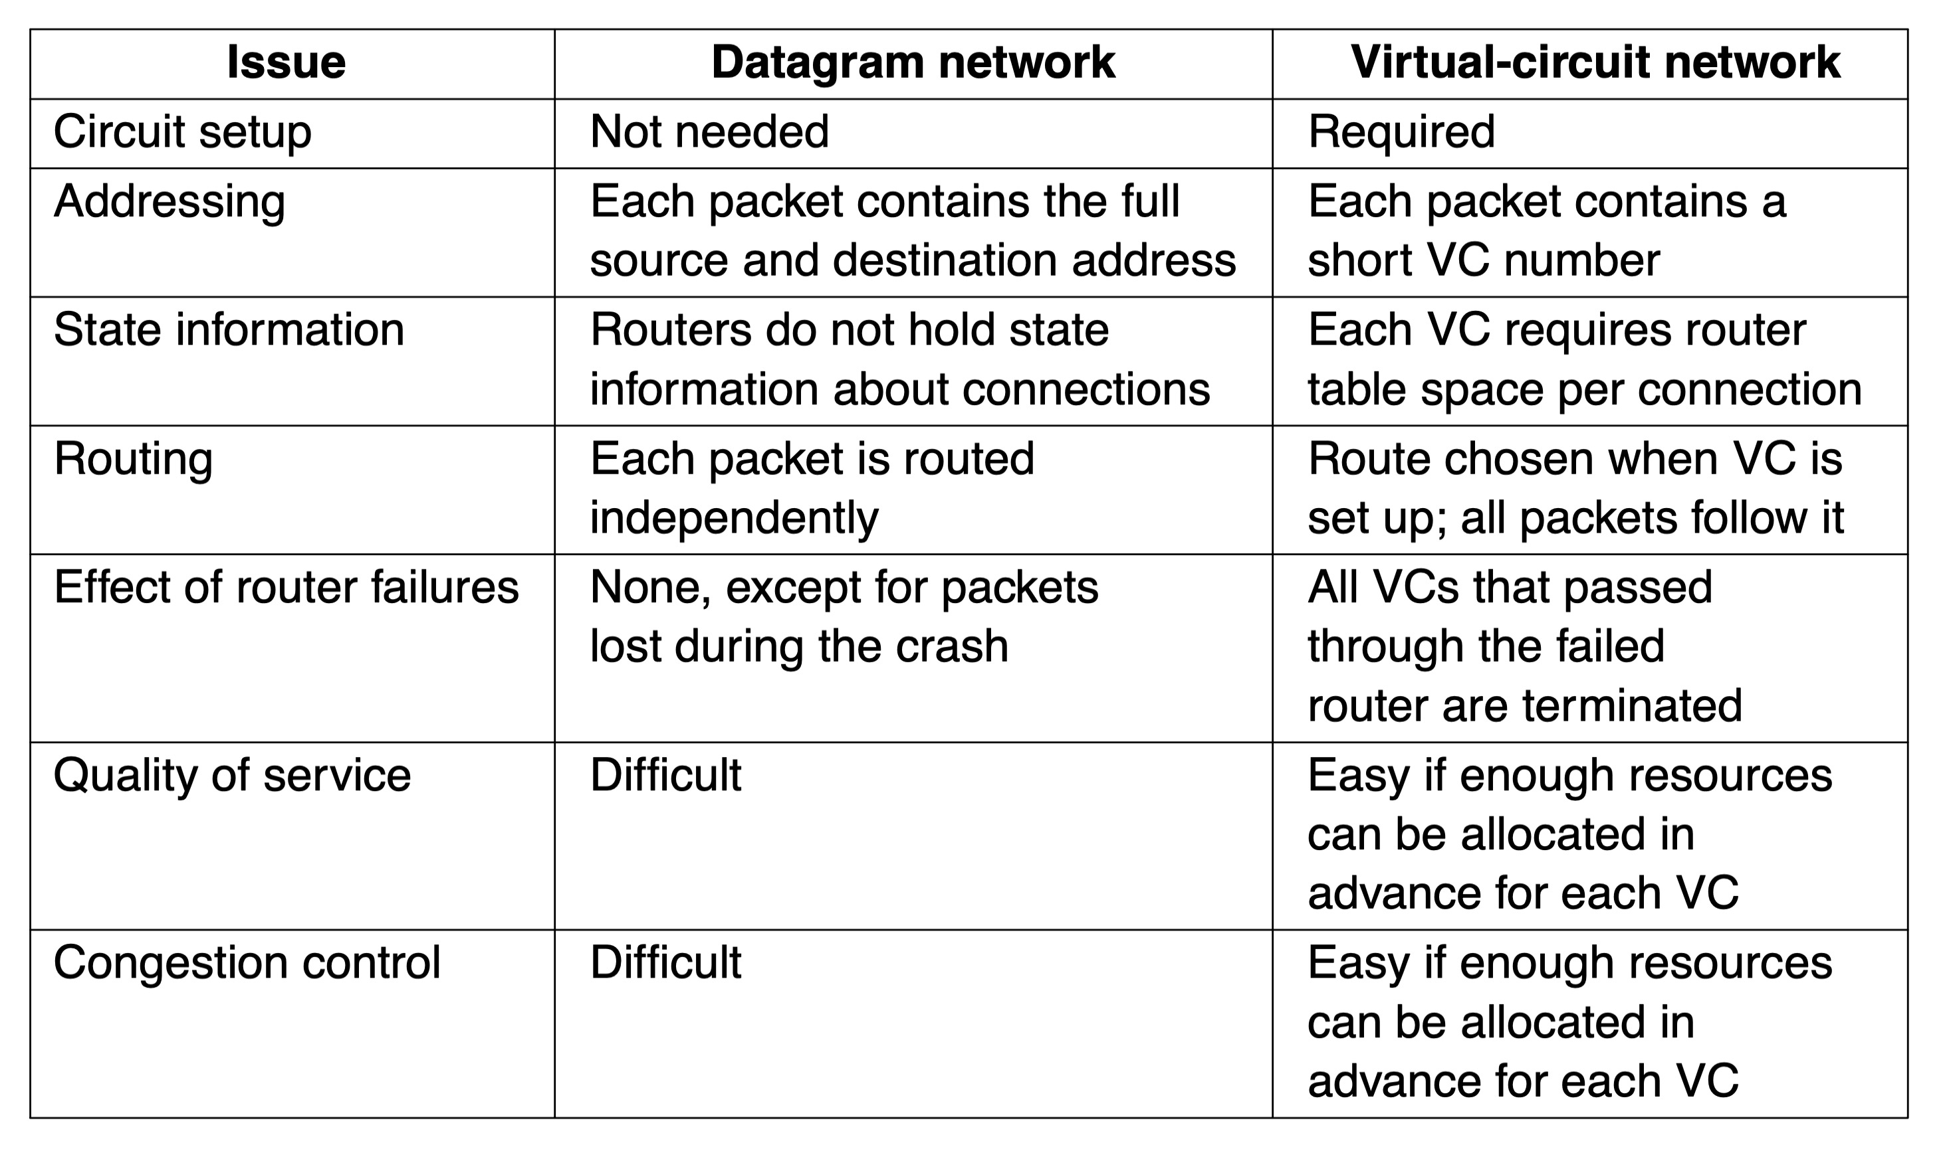
Comparison of Virtual-Circuit and Datagram Networks
Comparison of datagram and virtual-circuit networks

Slide 11
Routing Algorithms in a Single Network (1 of 3)
Optimality principle
Shortest path algorithm
Distance vector routing
Link state routing

Slide 12
Routing Algorithms in a Single Network (2 of 3)
Hierarchical routing within a network
Broadcast routing
Multicast routing
Anycast routing

Slide 13
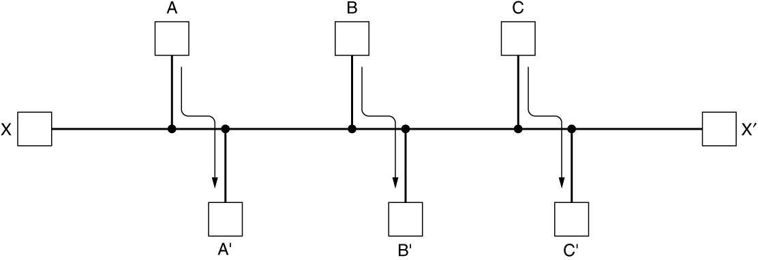
Routing Algorithms in a Single Network (3 of 3)
The routing algorithm is that part of the network layer software responsible for deciding which output line an incoming packet should be transmitted on.
Properties are desirable in a routing algorithm: correctness, simplicity, robustness, stability, fairness, and efficiency.
Nonadaptive algorithms do not base their routing decisions on any measurements or estimates of the current topology and traffic. Known as Static Routing.
Adaptive algorithms, in contrast, change their routing decisions to reflect changes in the topology, and sometimes changes in the traffic as well. Known as Dynamic Routing.
Network with a conflict between fairness and efficiency

Slide 14
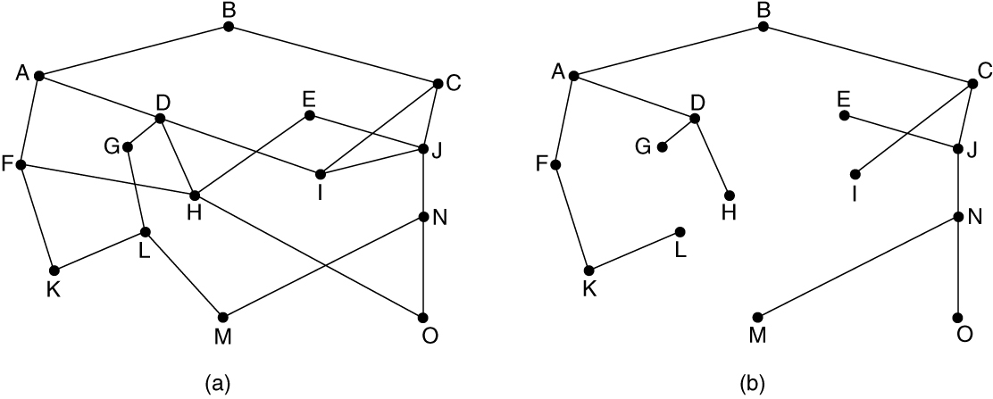
The Optimality Principle
One can make a general statement about optimal routes without regard to network topology or traffic. This statement is known as the optimality principle.
As a direct consequence of the optimality principle, the set of optimal routes from all sources to a given destination form a tree rooted at the destination. Such a tree is called a sink tree.
Note that a sink tree is not necessarily unique; other trees with the same path lengths may exist.
If we allow all of the possible paths to be chosen, the tree becomes a more general structure called a DAG (Directed Acyclic Graph).
(a) A network. (b) A sink tree for router B.

Slide 15
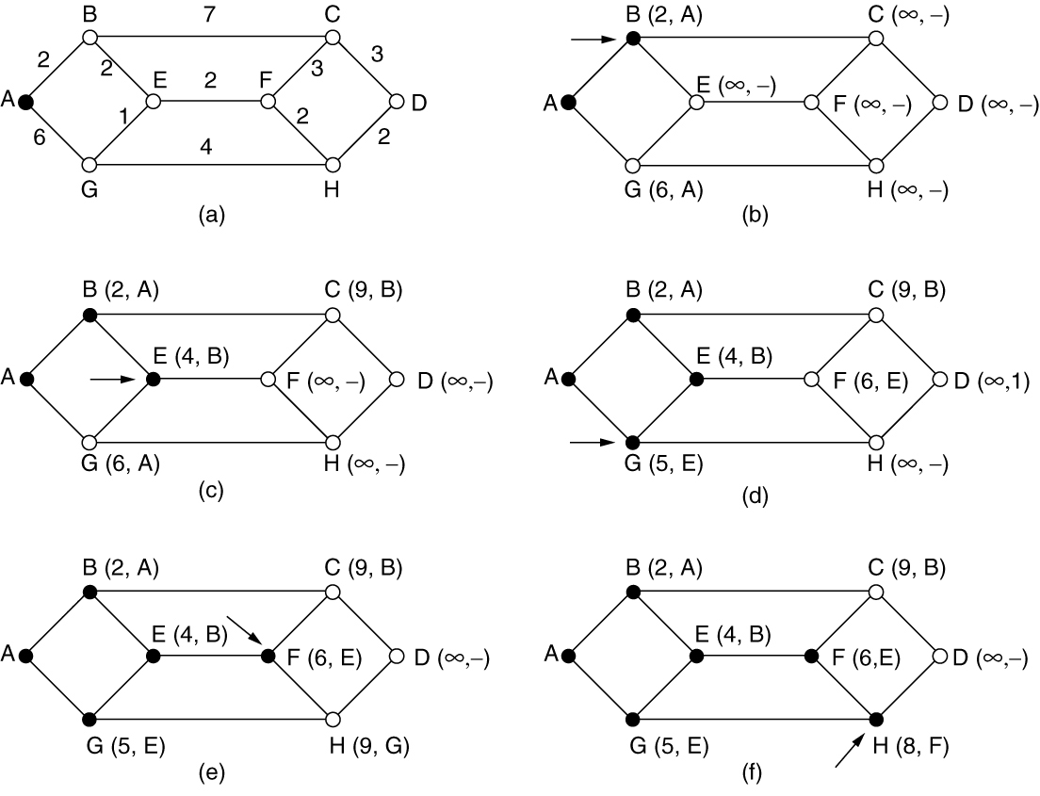
Shortest Path Algorithm (1 of 2)
The first six steps used in computing the shortest path from A to D. The arrows indicate the working node.

Slide 16
Question for you
What is the major difference between datagram network and virtual-circuit network?
What is a sink tree?

Slide 17
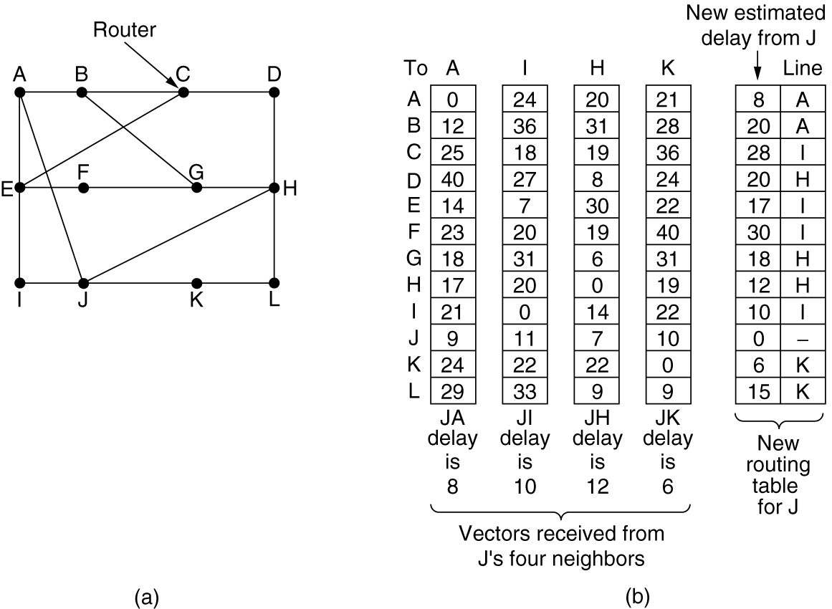
Distance Vector Routing
A distance vector routing algorithm AKA Bellman-Ford routing algorithm operates by having each router maintain a table (i.e., a vector) giving the best-known distance to each destination and which link to use to get there.
(a) A network. (b) Input from A, I, H, K, and the new routing table for J.
Drawback: Although it converges to the correct answer, it may do so slowly

Slide 18
Link State Routing
The idea behind link state routing is fairly simple and can be stated as five parts.
Discover neighbors, learn network addresses
Set distance/cost metric to each neighbor
Construct packet telling all it has learned
Send packet to, receive packets from other routers
Compute shortest path to every other router

Slide 19
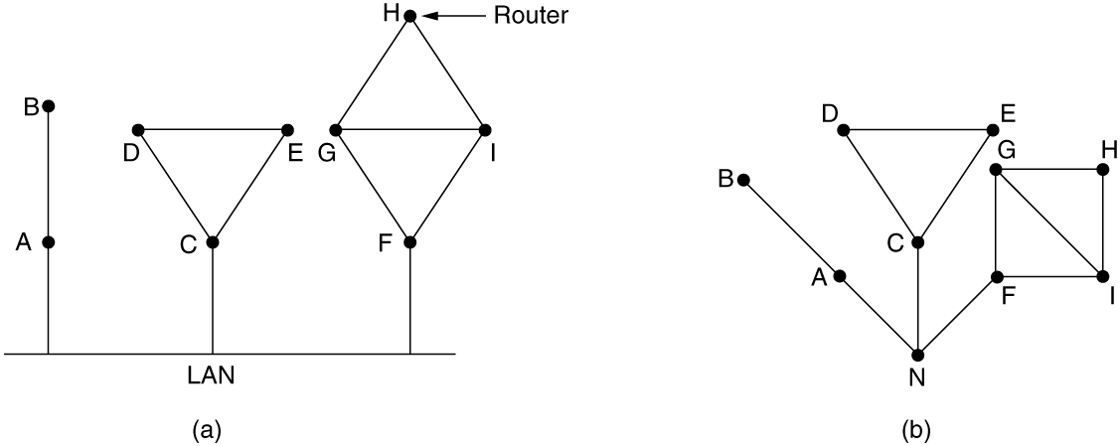
Learning about the Neighbors
Here, we have introduced a new, artificial node, N, to which A, C, and F are connected.
(a) Nine routers and a broadcast LAN. (b) A graph model of (a).
When a router is booted, its first task is to learn who its neighbors are. It accomplishes this goal by sending a special HELLO packet on each point-to-point line.
The router on the other end is expected to send back a reply giving its name. These names must be globally unique.

Slide 20
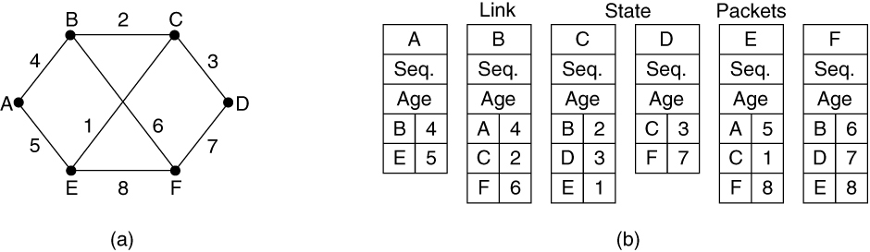
Building Link State Packets
(a) A network. (b) The link state packets for this network.
The packet starts with the identity of the sender, followed by a sequence number and age and a list of neighbors. The cost to each neighbor is also given.
The hard part is determining when to build packets. One possibility is to build them periodically, at regular intervals. Another possibility when some specific event occurs, such as a line or neighbor going down or coming back up again or changing its properties.
Drawback: Not only is router memory consumed by ever-increasing tables, but more CPU time is needed to scan them, and more bandwidth is needed to send status reports about them.

Slide 21
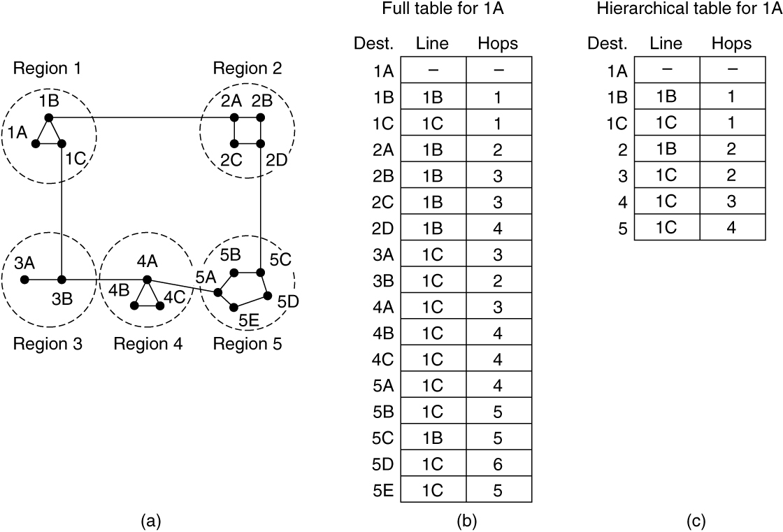
Hierarchical Routing within a Network
When hierarchical routing is used, the routers are divided into what we will call regions or areas.
Drawback: There is a penalty to be paid: increased path length. For example, the best route from 1A to 5C is via region 2, but with hierarchical routing all traffic to region 5 goes via region 3, because that is better for most destinations in region 5.
Hierarchical routing

Slide 22
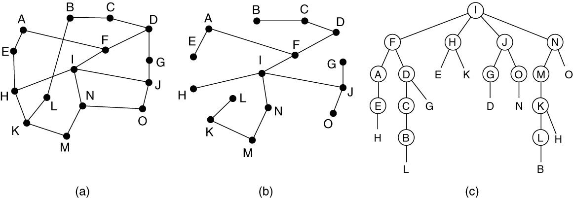
Broadcast Routing
Sending a packet to all destinations simultaneously is called broadcasting.
The principal advantage of reverse path forwarding is that it is efficient while being easy to implement.
It sends the broadcast packet over each link only once in each direction, just as in flooding, yet it requires only that routers know how to reach all destinations, without needing to remember sequence numbers (or use other mechanisms to stop the flood) or list all destinations.
Drawback: Each router must have knowledge of some spanning tree.
Reverse path forwarding. (a) A network. (b) Sink tree for router I. (c) The tree built by reverse path forwarding from I.

Slide 23
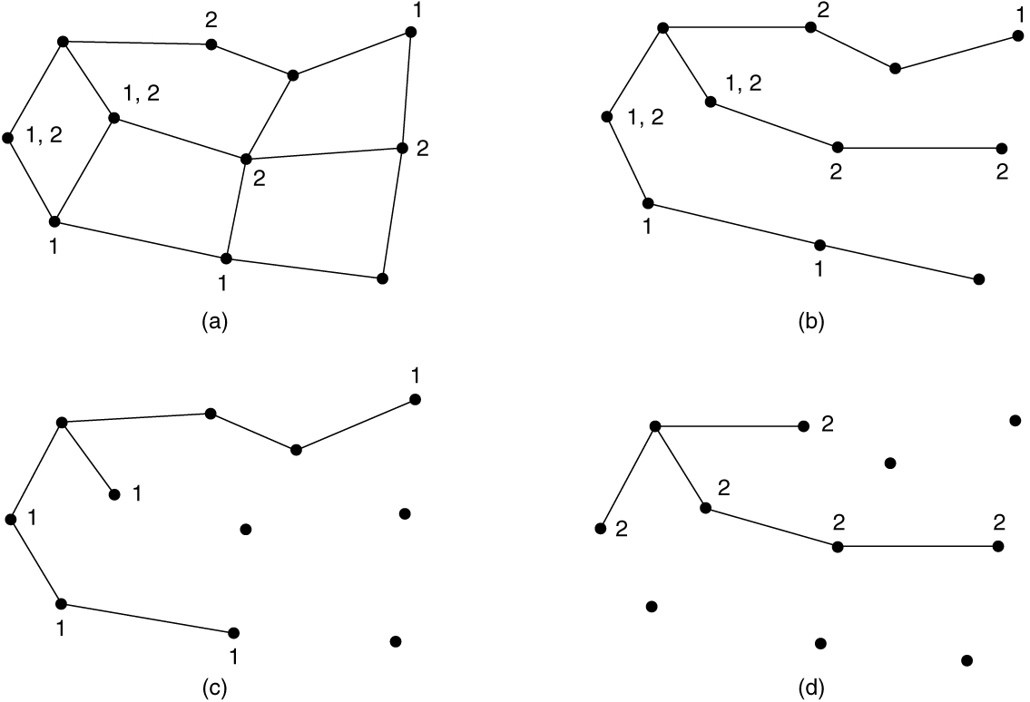
Multicast Routing (1 of 2)
Sending a message to such a group is called multicasting, and the routing algorithm used is called multicast routing.
The solution is to prune the broadcast spanning tree by removing links that do not lead to members. The result is an efficient multicast spanning tree.
Drawback: One potential disadvantage is that it is lots of work for routers, especially for very big networks.
(a) A network. (b) A spanning tree for the leftmost router. (c) A multicast tree for group 1. (d) A multicast tree for group 2.

Slide 24
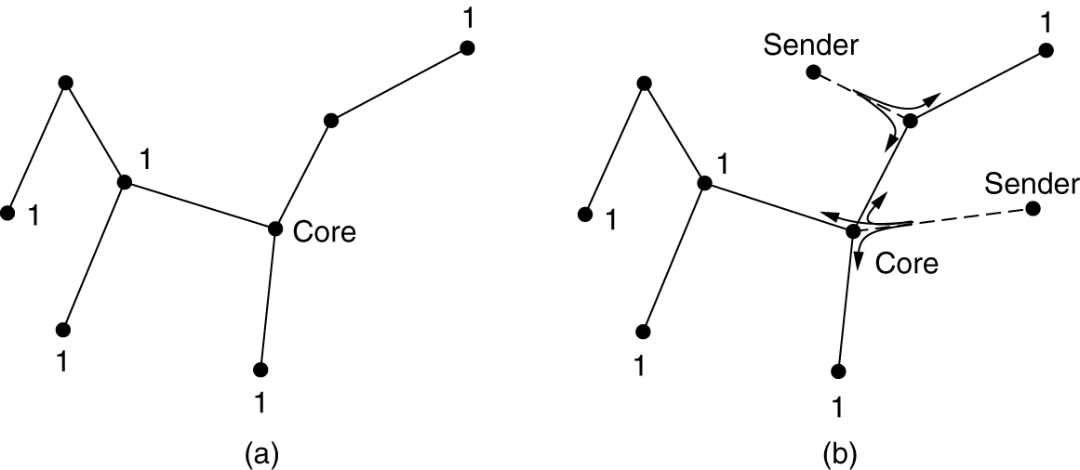
Multicast Routing (2 of 2)
An alternative design uses core-based trees to compute a single spanning tree for the group. All of the routers agree on a root (called the core) and build the tree by sending a packet from each member to the root. The tree is the union of the paths traced by these packets. Here, to send to the group 1, a sender sends a packet to the core. When the packet reaches the core, it is forwarded down the tree.
(a) Core-based tree for group 1. (b) Sending to group 1.

Slide 25
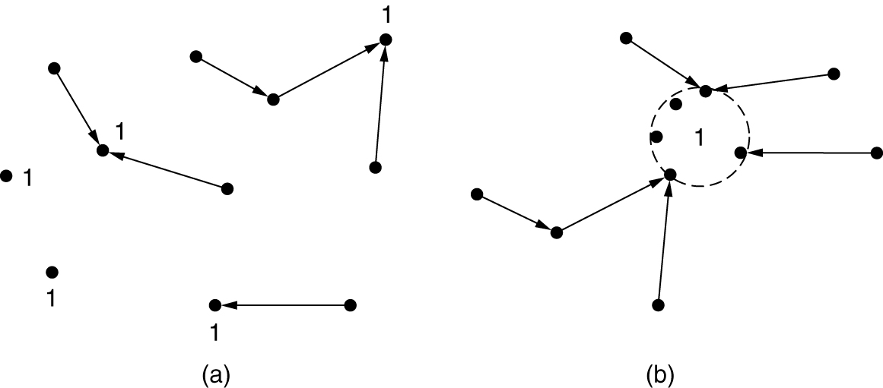
Anycast Routing
In anycast, a packet is delivered to the nearest member of a group. Schemes that find these paths are called anycast routing.
Suppose we want to anycast to the members of group 1. They will all be given the address “1,” instead of different addresses. Distance vector routing will distribute vectors as usual, and nodes will choose the shortest path to destination 1. This will result in nodes sending to the nearest instance of destination 1.
(a) Anycast routes to group 1. (b) Topology seen by the routing protocol.

Slide 26
Traffic Management at the Network Layer
The need for traffic management: congestion
Too many packets in any part of the network can ultimately introduce packet delay and loss that degrades performance. This situation is called congestion.
Approaches to traffic management
Traffic-aware routing
Admission control
Load shedding
Traffic shaping
Explicit congestion notification
Hop-by-hop backpressure

Slide 27
Traffic Management, Congestion control and Flow Control
Traffic management or engineering has to do with making sure the network is able to carry the offered traffic; it can be performed by devices in the network, or by the senders of traffic (often through mechanisms in the transport protocol, which are often referred to as congestion control).
Congestion management and control concerns the behavior of all the hosts and routers.
Flow control relates to the traffic between a particular sender and a particular receiver and is generally concerned with making sure that the sender is not transmitting data faster than the receiver can process it.

Slide 28
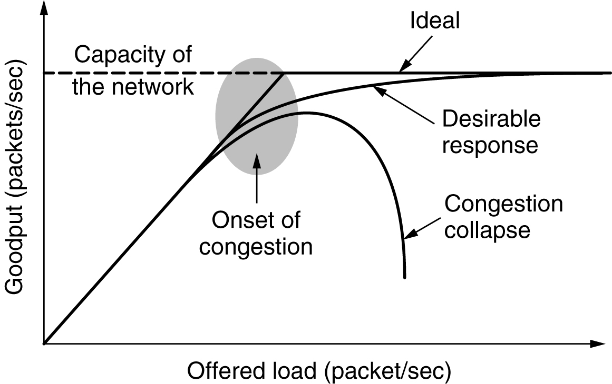
Congestion
Performance drops significantly in the presence of congestion: packet loss rates increase, and latency also increases as router queues fill with packets

Slide 29
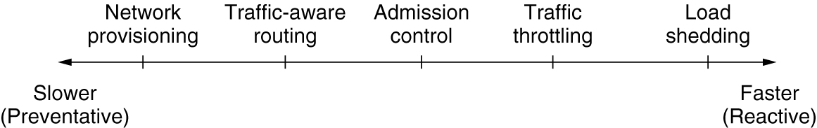
Approaches to Traffic Management
If there is a low-bandwidth link on the path along which most traffic is directed, congestion is likely.
The most straightforward way to avoid congestion is to build a network that is provisioned for the traffic load that it must carry.
More often, links and routers that are regularly heavily utilized are upgraded at the earliest opportunity. This is called provisioning and happens on a time scale of months, driven by long-term traffic trends.
Timescales of approaches to traffic and congestion management

Slide 30
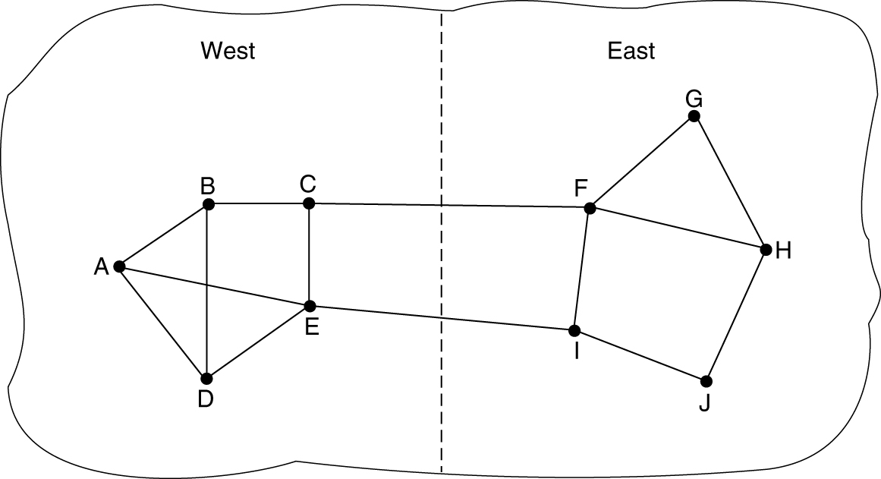
Traffic-Aware Routing
The goal in taking load into account when computing routes is to shift traffic away from hotspots that will be the first places in the network to experience congestion.
Set the link weight to be a function of the (fixed) link bandwidth and propagation delay plus the (variable) measured load or average queueing delay. Least-weight paths will then favor paths that are more lightly loaded, all else being equal.
Disadvantage: Routing tables may oscillate wildly, leading to erratic routing and many potential problems.
A network in which the East and West parts are connected by two links

Slide 31
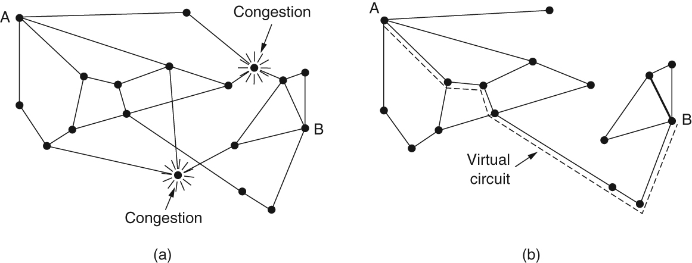
Admission Control
One technique that is widely used in virtual-circuit networks to keep congestion at bay is admission control. The idea is simple: do not set up a new virtual circuit unless the network can carry the added traffic without becoming congested.
Admission control can be combined with traffic-aware routing by considering routes around traffic hotspots as part of the setup procedure.
(a) A congested network. (b) The portion of the network that is not congested. A virtual circuit from A to B is also shown.

Slide 32
Load Shedding
When none of the above methods make the congestion disappear, routers can bring out the heavy artillery: load shedding. This is a fancy way of saying that when routers are being inundated by packets that they cannot handle, they just throw them away.
The key question for a router drowning in packets is which packets to drop. For a file transfer, an old packet is worth more than a new one. In contrast, for real-time media, a new packet is worth more than an old one.
The former policy (old is better than new) is often called wine and the latter (new is better than old) is often called milk because most people prefer new milk over old milk and old wine over new wine.

Slide 33
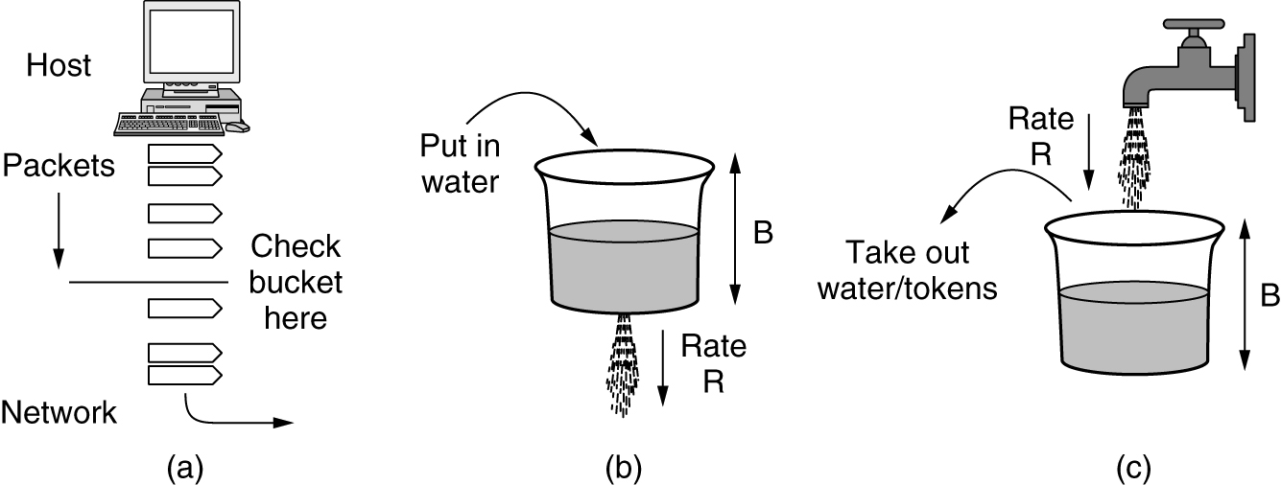
Traffic Shaping (1 of 2)
Traffic shaping is a technique for regulating the average rate and burstiness of a flow of data that enters the network. The goal is to allow applications to transmit a wide variety of traffic that suits their needs. When a flow is set up, the user and the network (i.e., the customer and the provider) agree on a certain traffic pattern (i.e., shape) for that flow. In effect, the customer says to the provider “My transmission pattern will look like this; can you handle it?”
(a) Shaping packets. (b) A leaky bucket. (c) A token bucket.

Slide 34
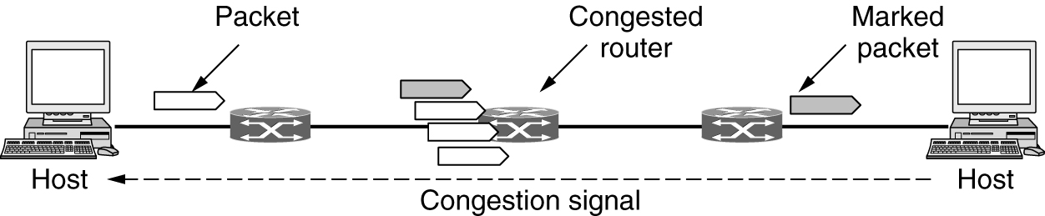
Explicit Congestion Notification
Instead of generating additional packets to warn of congestion, a router can tag any packet it forwards (by setting a bit in the packet’s header) to signal that it is experiencing congestion. When the network delivers the packet, the destination can note that there is congestion and inform the sender when it sends a reply packet. The sender can then throttle its transmissions. This design is called ECN (Explicit Congestion Notification)
Explicit congestion notification

Slide 35
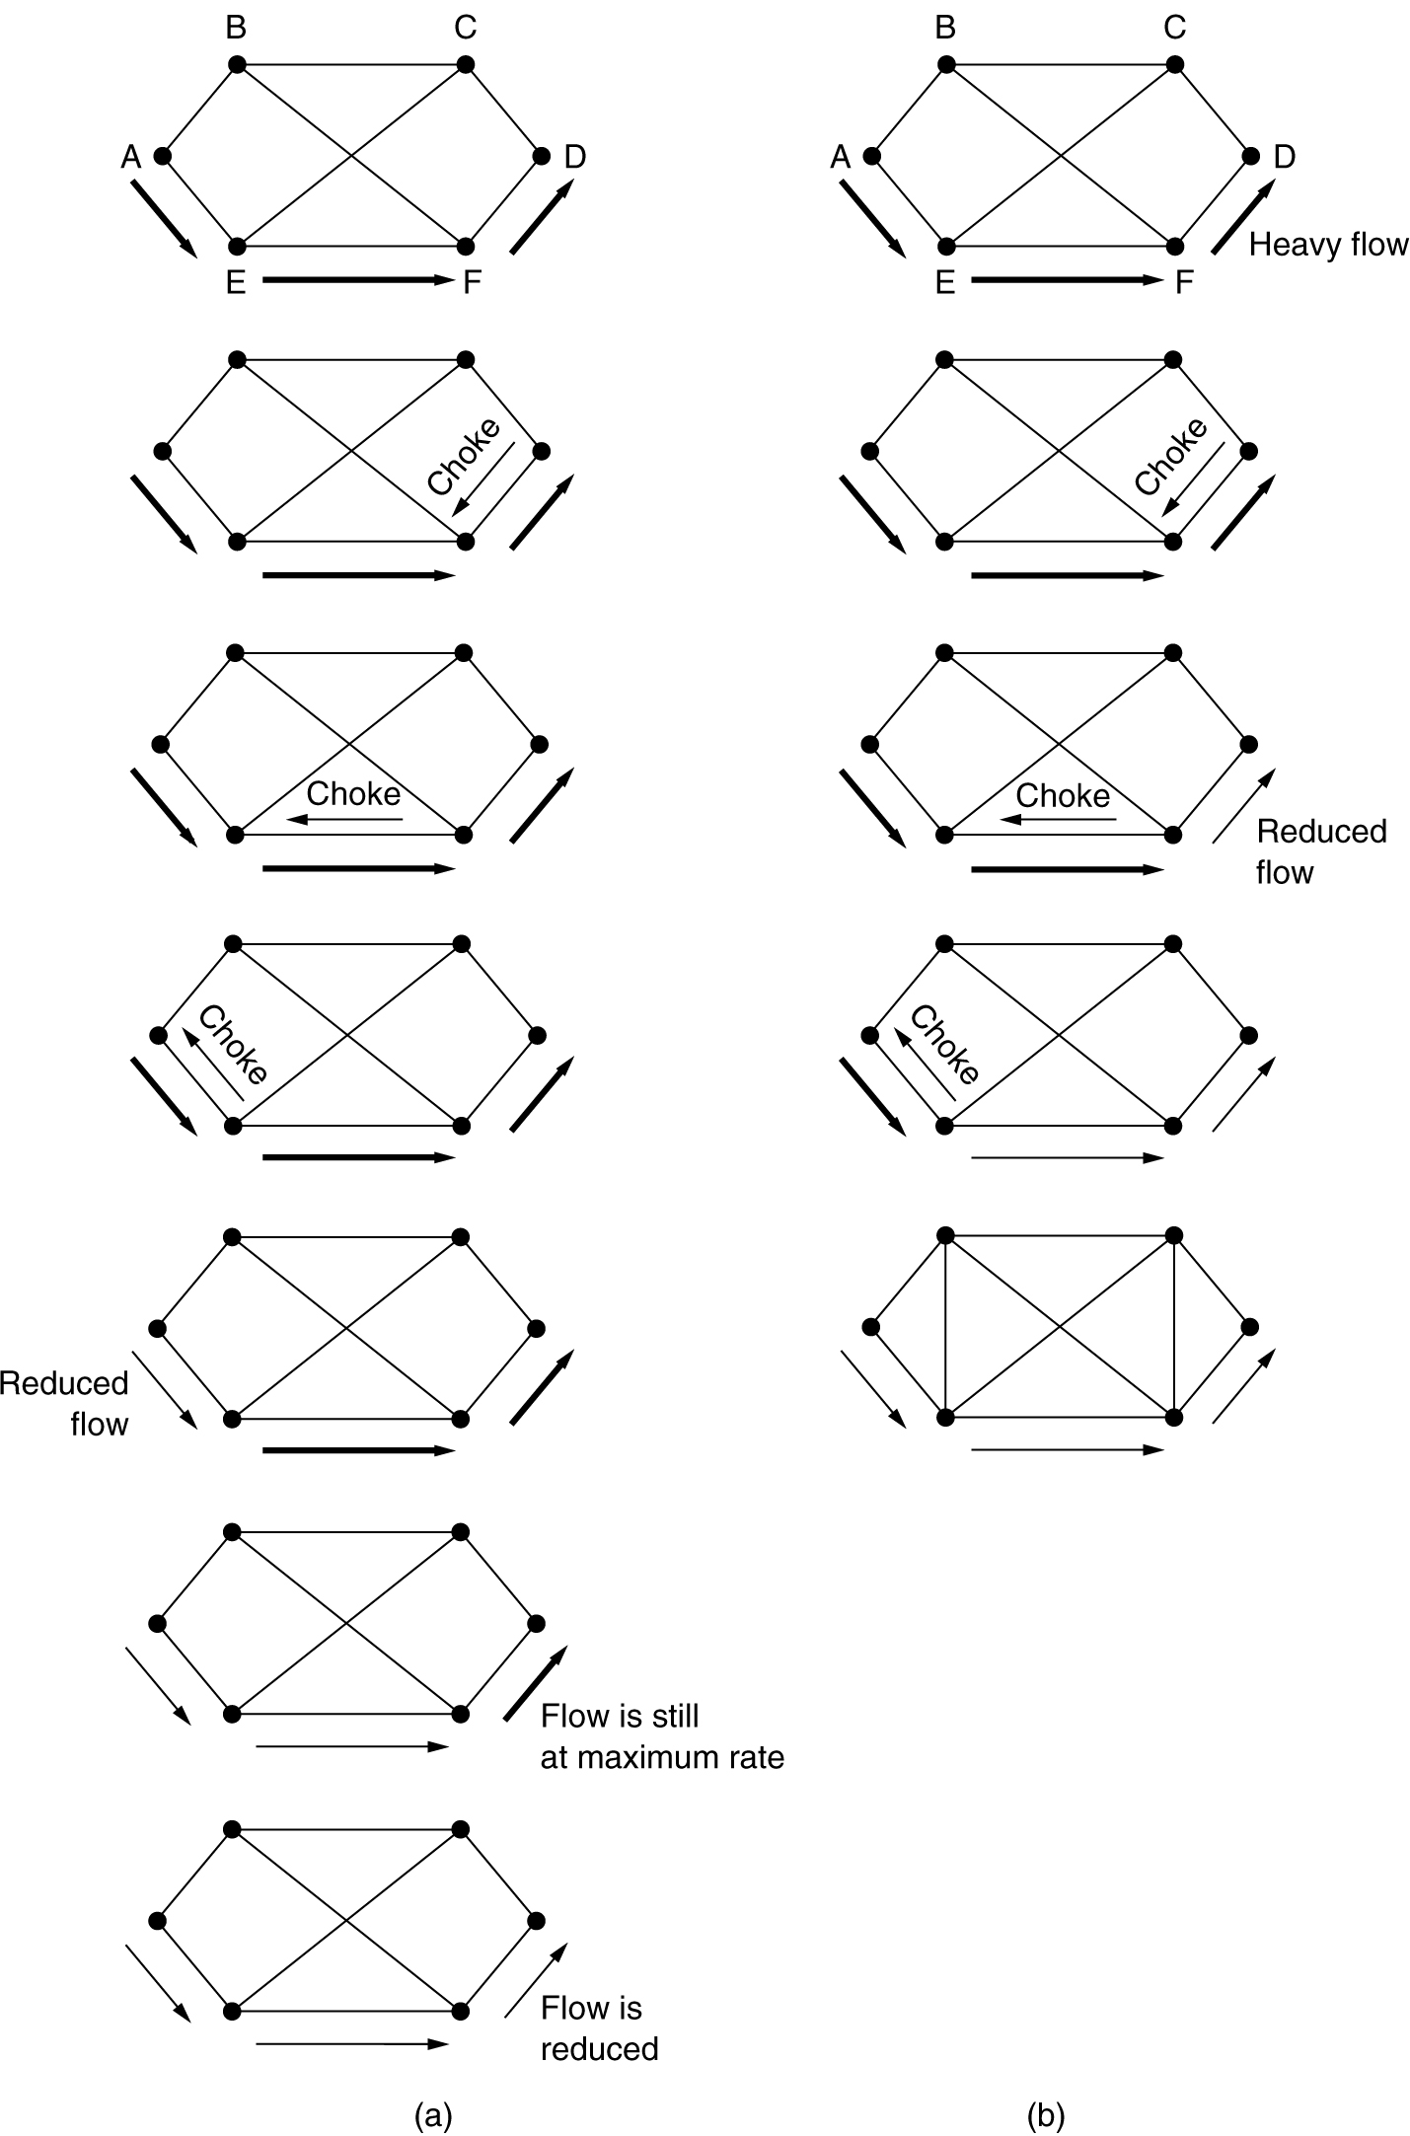
Hop-by-Hop Backpressure
An alternative approach is to have the choke packet take effect at every hop it passes through, as shown in the sequence of (b). Here, as soon as the choke packet reaches F, F is required to reduce the flow to D. Doing so will require F to devote more buffers to the connection, since the source is still sending away at full blast, but it gives D immediate relief.
The net effect of this hop-by-hop scheme is to provide quick relief at the point of congestion, at the price of using up more buffers upstream.
(a) A choke packet that affects only the source. (b) A choke packet that affects each hop it passes through.

Slide 36
Questions for you
What is the difference among Traffic Management, Congestion control and Flow Control?
What is congestion?
What is Traffic aware routing? Disadvantage?
How admission control works?
What is load shedding? Which packets to drop?
How traffic shaping works?
What is explicit congestion notification?
How hop-by-hop backpressure works?

Slide 37
Quality of Service and Application QoE
A stream of packets from a source to a destination is called a flow.
The needs of each flow can be characterized by four primary parameters: bandwidth, delay, jitter, and loss.
Together, these four determine the QoS (Quality of Service) the flow requires.

Slide 38
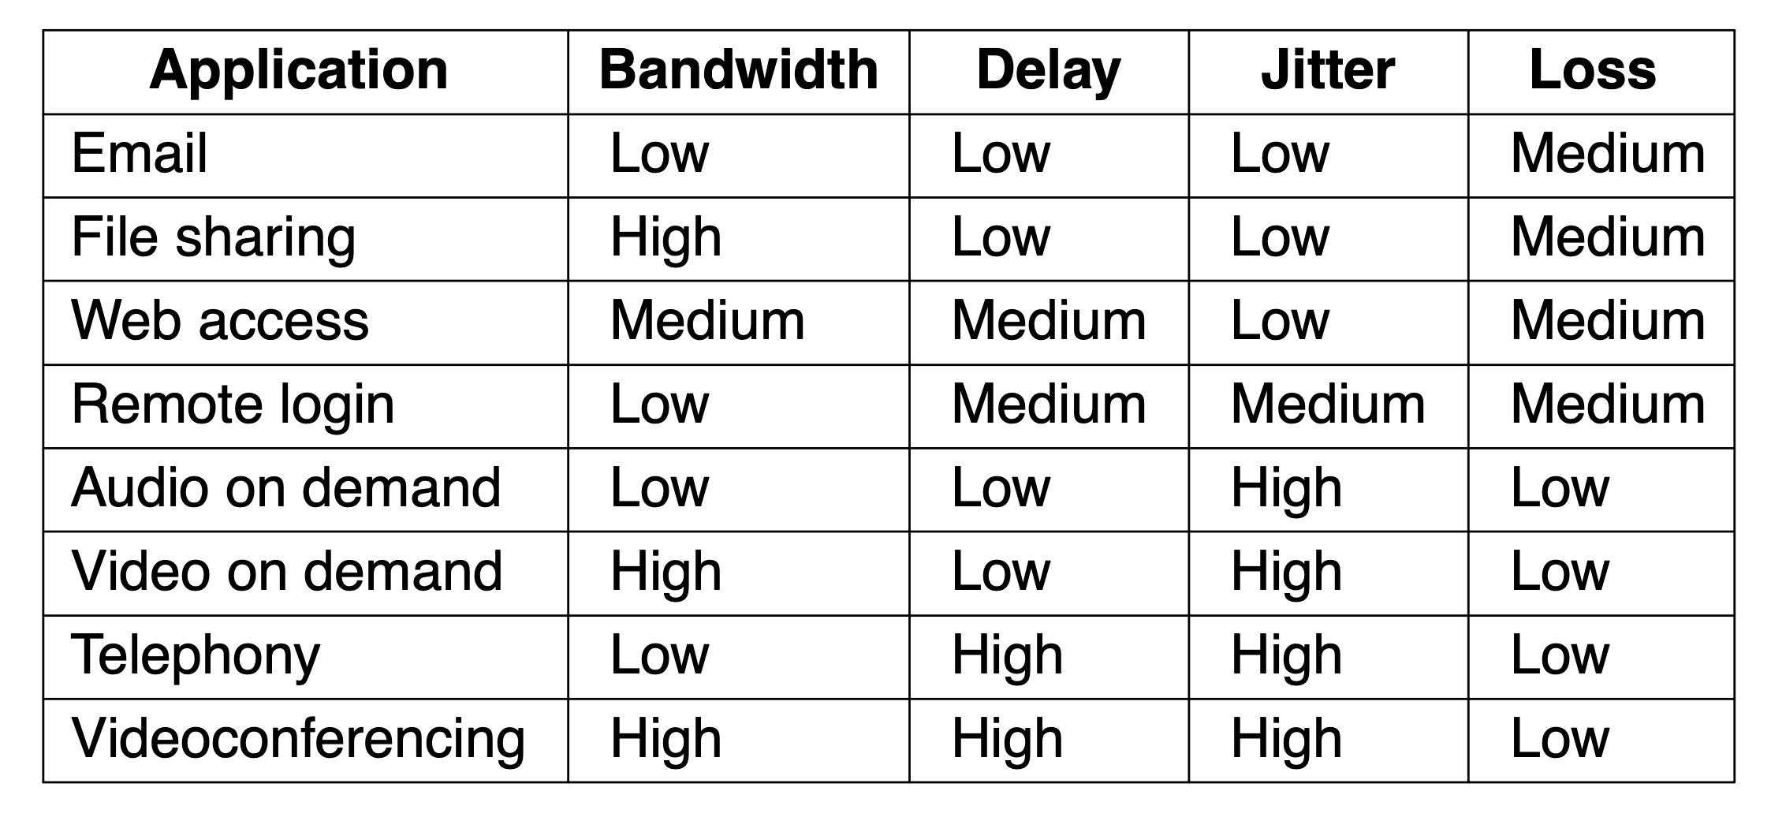
Application QoS Requirements
Stringency of applications’ quality-of-service requirements

Slide 39
Overprovisioning
Helps to provide good quality of service
Ensure the network has the capacity for all traffic
Expensive solution
Network issues to address for quality of service
Addressing applications needs
Regulating traffic entering the network
Reserving resources at routers to guarantee performance
Safely accepting more traffic

Slide 40
Packet Scheduling
Algorithms that allocate router resources among the packets of a flow and between competing flows are called packet scheduling algorithms.
Router resources reserved for different flows
Bandwidth
Buffer space
CPU cycles
Algorithms
First-In First-Out (FIFO) scheduling
Fair queueing
Weighted fair queueing

Slide 41
First-In First-Out (FIFO) scheduling
Each router buffers packets in a queue for each output line until they can be sent.
They are sent in the same order that they arrived.
This algorithm is known as FIFO (First-In First-Out), or equivalently FCFS (First-Come First-Served).
Disadvantage: Processing packets in the order of their arrival means that the aggressive sender can hog most of the capacity of the routers its packets traverse, starving the other flows and reducing their quality of service.

Slide 42
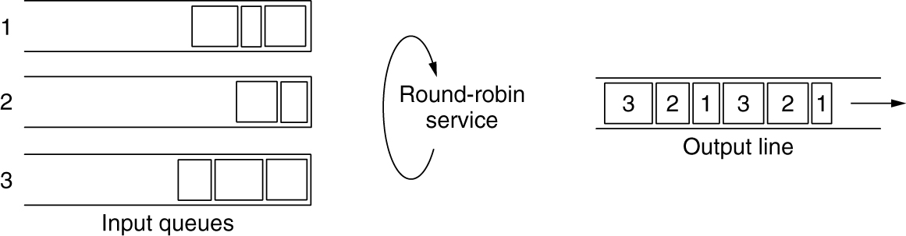
Fair Queueing
The essence of this algorithm is that routers have separate queues, one for each flow for a given output line.
When the line becomes idle, the router scans the queues round robin.
In this way, with n hosts competing for the output line, each host gets to send one out of every n packets.
It is fair in the sense that all flows get to send packets at the same rate. Sending more packets will not improve this rate.
Disadvantage: it gives more bandwidth to hosts that use large packets than to hosts that use small packets.

Slide 43
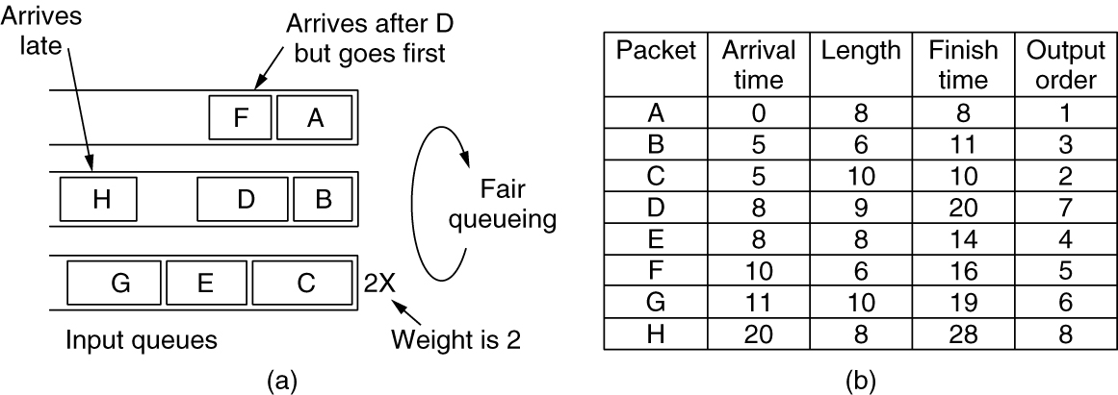
Improved Fair Queueing
Round robin is done in such a way as to simulate a byte-by-byte round robin, instead of a packet-by-packet round robin.
The trick is to compute a virtual time that is the number of the round at which each packet would finish being sent. Each round drains a byte from all of the queues that have data to send. The packets are then sorted in order of their finishing times and sent in that order.
The relative sending order is A, B, F, D, even though F arrived after D
Disadvantage: It gives all hosts the same priority.
(a) Weighted Fair Queueing. (b) Finishing times for the packets.

Slide 44
Weighted Fair Queueing
In many situations, it is desirable to give, for example, video servers more bandwidth than, say, file servers.
This is easily possible by giving the video server two or more bytes per round. This modified algorithm is called WFQ (Weighted Fair Queueing).
(a) Weighted Fair Queueing. (b) Finishing times for the packets.

Slide 45
Internetworking
When two or more networks are connected, they form an internetwork, or more simply an internet.
How networks differ
Connecting heterogeneous networks
Connecting endpoints across heterogeneous networks
Supporting different packet sizes: packet fragmentation

Slide 46
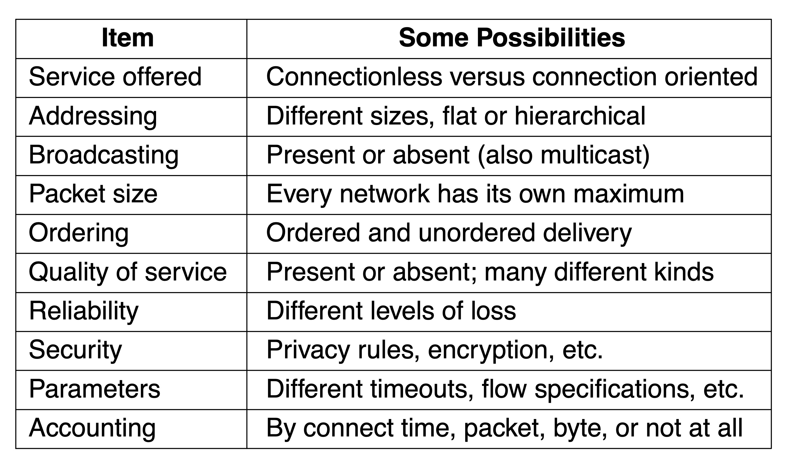
How Networks Differ
Some of the many ways networks can differ

Slide 47
Questions for you
FIFO
Fair Queueing
Improved Fair Queueing
Weighted Fair Queueing

Slide 48
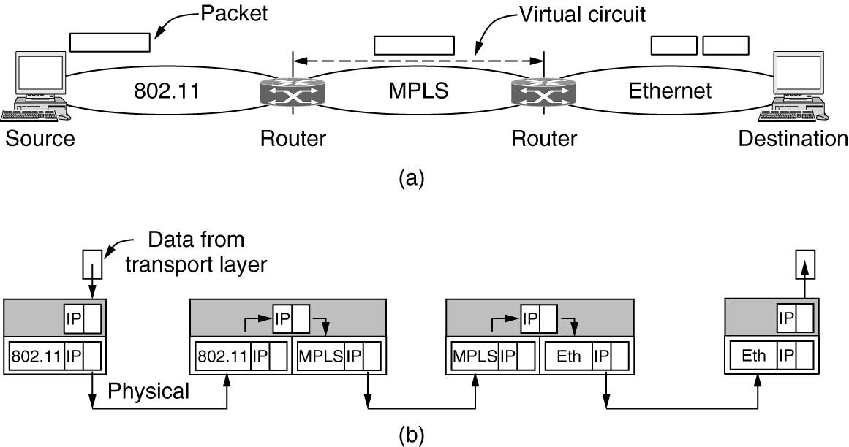
Connecting Heterogeneous Networks
Because different networks may, in general, have different forms of addressing, the packet carries a network layer address that can identify any host across the three networks.
Once the packet has traveled along the virtual circuit, it will reach the Ethernet network.
The packet may be too large to be carried, since 802.11 can work with larger frames than Ethernet.
To handle this problem, the packet is divided into fragments, and each fragment is sent separately. When the fragments reach the destination, they are reassembled.
(a) A packet crossing different networks. (b) Network and link layer protocol processing.

Slide 49
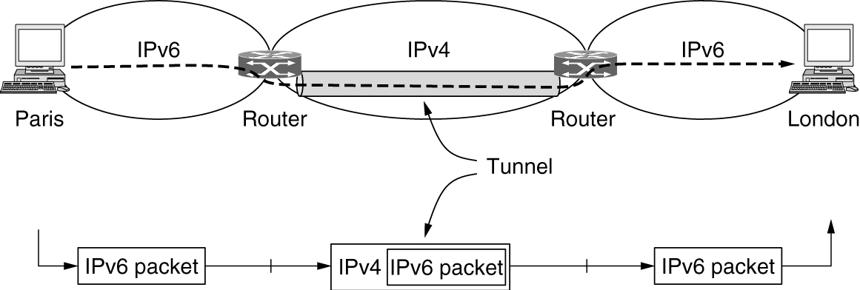
Connecting Endpoints Across Heterogeneous Networks
A common special case is where the source and destination hosts are on the same type of network, but there is a different network in between.
The solution to this problem is a technique called tunneling.
To send an IP packet to a host in the London office, a host in the Paris office constructs the packet containing an IPv6 address in London and sends it to the multiprotocol router that connects the Paris IPv6 network to the IPv4 Internet.
When this in between router gets the IPv6 packet, the router puts the (IPv6) packet inside a (IPv4) packet. When this wrapped packet arrives, the London router removes the original IPv6 packet and sends it onward to the destination host.

Slide 50
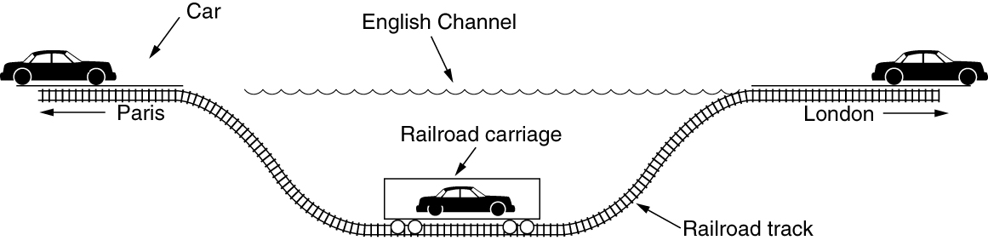
Connecting Endpoints Across Heterogeneous Networks (2 of 2)
An analogy may make tunneling clearer. Consider a person driving her car from Paris to London. Within France, the car moves under its own power, but when it hits the English Channel, it is loaded onto a high-speed train and transported to England through the Chunnel (cars are not permitted to drive through the Chunnel). Effectively, the car is being carried as freight. At the far end, the car is let loose on the English roads and once again continues to move under its own power. Tunneling of packets through a foreign network works the same way.

Slide 51
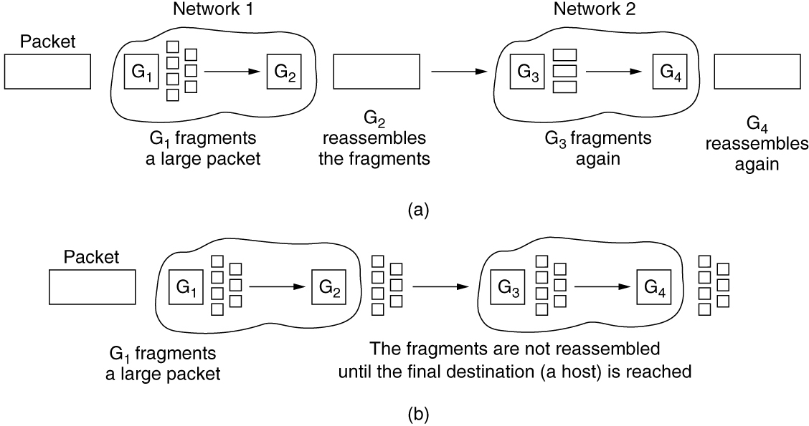
Supporting Different Packet Sizes: Packet Fragmentation
Transparent fragmentation is straightforward but has some problems (??).
The main advantage of nontransparent fragmentation is that it requires routers to do less work.
(a) Transparent fragmentation. (b) Non transparent fragmentation.

Slide 52
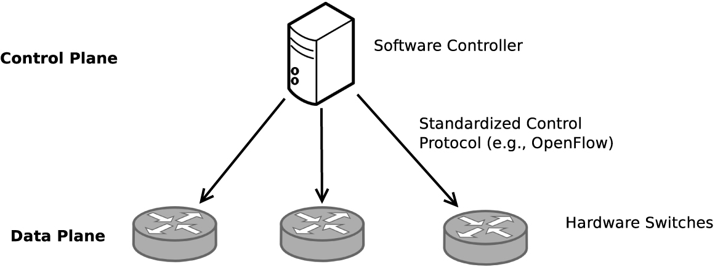
Software-Defined Networking
One of the main concepts driving SDN was to recognize that the control plane, the software and logic that select routes and decide what to do with forwarding traffic, runs in software and can operate completely separately from the data plane, the hardware-based technology that is responsible for actually performing lookups on packets and deciding what to do with them.
Control and data plane separation in SDN

Slide 53
The Network Layer in the Internet
Top 10 principles
Make sure it works
Keep it simple
Make clear choices
Exploit modularity
Expect heterogeneity
Avoid static options and parameters
Look for a good design; it need not be perfect
Be strict when sending and tolerant when receiving
Think about scalability
Consider performance and cost

Slide 54
The Network Layer in the Internet
In the network layer, the Internet can be viewed as a collection of networks or Autonomous Systems (ASes) that are interconnected. There is no real structure, but several major backbones exist.
The biggest of these backbones, to which everyone else connects to reach the rest of the Internet, are called Tier 1 networks. Attached to the backbones are ISPs (Internet Service Providers) that provide Internet access to homes and businesses, data centers and colocation facilities full of server machines, and regional (mid-level) networks.
The glue that holds the whole Internet together is the network layer protocol, IP (Internet Protocol). Unlike almost all older network layer protocols, IP was designed from the beginning with internetworking in mind.

Slide 55
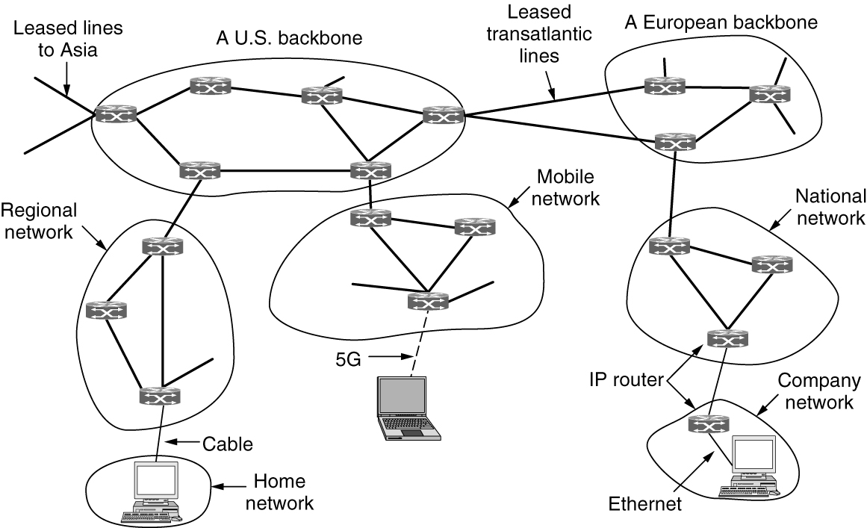
The Network Layer in the Internet
The Internet is an interconnected collection of many networks.

Slide 56
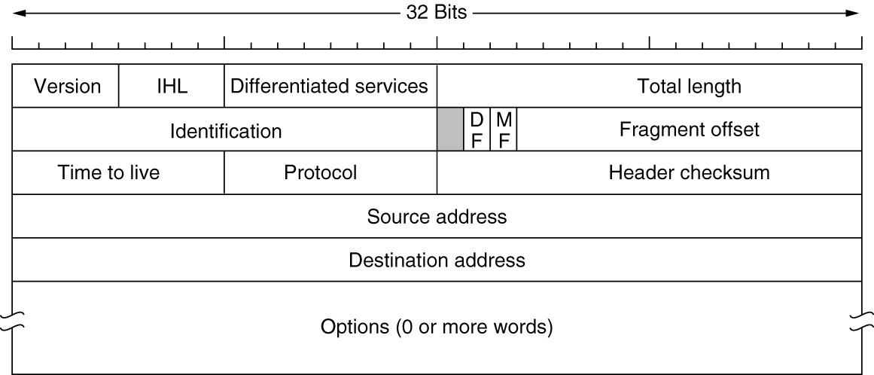
The IP Version 4 Protocol
An IPv4 datagram consists of a header part and a body or payload part. The header has a 20-byte fixed part and a variable-length optional part.
The IPv4 (Internet Protocol version 4) header

Slide 57
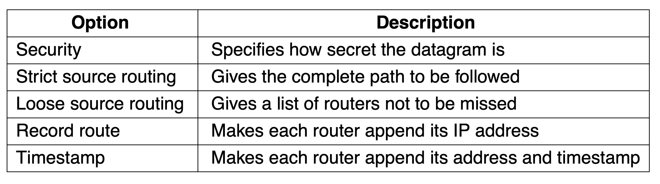
The IP Version 4 Protocol
Some of the IP options

Slide 58
Policy at the Network Layer
Peering disputes
A breakdown in negotiations over paying for transit
Traffic prioritization
Generally agreed upon bright-line rules
No blocking
No throttling
No paid prioritization
Disclosure of any prioritization practices

Slide 59

Copyright
This work is protected by United States copyright laws and is provided solely for the use of instructors in teaching their courses and assessing student learning. Dissemination or sale of any part of this work (including on the World Wide Web) will destroy the integrity of the work and is not permitted. The work and materials from it should never be made available to students except by instructors using the accompanying text in their classes. All recipients of this work are expected to abide by these restrictions and to honor the intended pedagogical purposes and the needs of other instructors who rely on these materials.

